Slide 1
Text by Jerry van Heerikhuize, Images by GROK Imagine, v1.0 October 2025
Key definitions for this presentation
State: The mechanism which a system retains and uses information over time, connecting past interactions to current behaviour.
Deterministic: Produce the same output every time for a given input.
Probabilistic: Outcomes are based on likelihoods derived from statistical patterns. It’s about predicting what’s likely to happen.
Stochastic: Randomness, actually selecting outcomes based on these probabilistic outputs.
Monolithic: A monolithic application is a single unified software application that is self-contained and independent from other applications.
Agentic: A subset of generative AI that is centered around the orchestration and execution of agents (that use LLMs as a "brain“) to delegate topics.
Hallucinations: Output containing inaccuracies or non-sensical information.
Seed: Numerical starting points that let creators reproduce or vary results in image and video generation, represented as a dice roll.
NPC: A term for characters in a video game that are controlled by the game’s controller, rather than a human player.
From Chaos to Control
Taming LLM State & Reasoning with MVC

Slide 2
Agenda
THE CHALLENGES I’M FACING USING LLMs
A GAME AS A PERFECT PROOF OF CONCEPT
T.A.G. THE TEXT ADVENTURE GENERATOR
THE MASTER PROMPT
[USECASE T.A.G. DEMO]
[USECASE T.B.A. DEMO]
NEXT STEPS?
FUN FACTS
DO YOU HAVE QUESTIONS?

Slide 3
TLDR;
The Result
A deterministic, stateful application from a probabilistic tool
The Pattern
MVC provides a classic, robust structure for control
1
2
3
4
The Problem
LLMs are fuzzy & forgetful
The Method
A <MODEL> (JSON) for state, <CONTROLLER> (Rules) for reasoning

Slide 4

THE CHALLENGES I’M FACING USING LLMs

Slide 5
THE CHALLENGES I’M FACING USING LLMs
“The finite context window”, keeping persistent memory or state
Deterministic Reasoning for consistent output
[BONUS] Taming hallucinations
[EXTRA BONUS] Structuring large prompts

Slide 6
THE finite context window
“I like the conversational aspects of an LLM. However, when I’m talking a long time diving deeper into a subject, or referring to earlier steps of a conversation it appears to lose context. Sometimes even after a reminder.”
An LLMs’ "memory" is like a whiteboard with limited space (the finite context window).
It's great for real-time collaboration and brainstorming.
But as you keep writing, the LLM has to erase the oldest notes at the top to make room for new ones.
When you ask about those erased notes, the LLM has no way to retrieve them.
There is no persistent state, or memory nodes.

Slide 7
Deterministic reasoning
“If you ask an LLM the exact same question twice, or across different chat sessions, you'll often get different answers. Its 'reasoning' can seem a bit... fuzzy, not always following a clear, predictable path. This is because LLMs are designed with a degree of randomness (stochasticity) to make them more creative and less repetitive.”
Stochasticity in LLMs:
LLM models are probabilistic; they sample from possible next words.
Temperature Parameter via the API: Controls the randomness (e.g., higher temperature = more creative/less deterministic).
No Universal Seed: Standard LLM chat interfaces typically don't expose a seed for text generation, leading to varied outputs.
Determinism in text-to-image:
Random Seed Initialization: A numerical seed initializes the random process that guides image synthesis.
Reproducible Outputs: The same seed, prompt, and model parameters guarantee the same visual result.
Determinism is essential for tasks like debugging, fine-tuning, and analysis.

Slide 8
[EXTRA BONUS] Structuring large prompts
Don't write a paragraph, build a template.
I found that if my prompts become really large it’s hard to maintain a proper structure. Should I use Markdown to group sections? Markup? I found that a combination of the two works best, both for me as for the LLM.
Don't write a paragraph, build a template.
Unstructured prompts rely on the LLM to guess your intent.
Use Markdown (##, *, 1.) for clear visual and logical hierarchy.
Use Markup Tags like <CORE_DIRECTIVES> or <ROLE>) to explicitly label different types of content.
The Result: A clear, maintainable prompt that delivers far more reliable and accurate output from the LLM.

Slide 9

A GAME AS A PERFECT PROOF OF CONCEPT

Slide 10
A GAME AS A PERFECT PROOF OF CONCEPT
Games are fundamentally stateful;
Games operate under specific rules (reasoning & logic);
A game world has a dynamic and evolving context;
Games require in-context problem solving;
If I can control a game, I can control any stateful application.

Slide 11
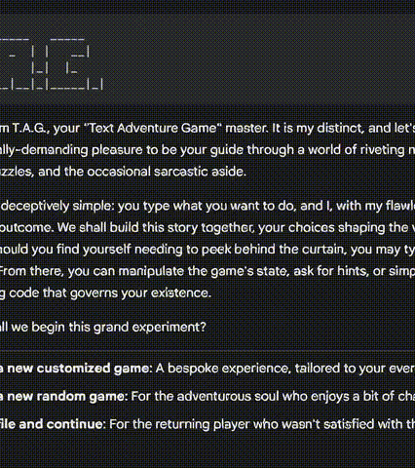
T.A.G.
The Text Adventure Generator

Slide 12


The Funny DUNGEON MASTER
I was thinking about a game which I’m able to play via a chat interface. Then I thought about the games I played as a kid.
Text adventures like Zork and The Hitchhiker's Guide to the Galaxy.
Why not use the power of a LLM to generate complete worlds and have way more conversational options than “put a in b”?

Slide 13

THE MASTER PROMPT

Slide 14
WHY I Prefer a MONOLITHIC OVER AN AGENTIC APPROACH
Simplicity & Reduced Complexity: Easier to design, Implement and maintain. No orchestration logic is required, which could lead to misalignment.
Fewer Failure Points: Each additional LLM call and integration point introduces a potential new failure point.
Cost-Effectiveness: Significantly Lower Costs and footprint.
Better Latency: A single LLM typically processes the entire request in one go, leading to faster response times.
Cohesion and Context Consistency: In a single LLM, the entire "thought process" (planning, execution, reflection) is contained within one context window.
Simpler Prompt Engineering: You only need to optimize one master prompt that guides the LLM through all phases of the task.
Usecases as a single prompt: I keep a github repository with a gallery of usecases in prompt.md files.

Slide 15
THE MASTER PROMPT : MVC A familiar pattern
Instead of struggling with the LLM, let's structure it. We can adapt a classic software pattern to enforce control:
Model-View-Controller (MVC)
Model: The single, persistent source of truth (The game's state, user's memory).
View: The narrative presented to the user (The story, the chat response).
Controller: The logic that processes input and updates the model (The rules).
<MASTER_PROMPT> <CORE_DIRECTIVES></CORE_DIRECTIVES> <MODEL>{}</MODEL> <CONTROLLER></CONTROLLER> <DIRECTIVES></DIRECTIVES> <GAME_PHASES></GAME_PHASES> <GAME_RULES></GAME_RULES> <GAMELOOP></GAMELOOP> <CONSOLE_COMMANDS> <DIRECTIVES></DIRECTIVES> </CONSOLE_COMMANDS> </CONTROLLER> <VIEW> <DIRECTIVES></DIRECTIVES> <OUTPUT></OUTPUT> </VIEW>
<BOTS> <ASCII_MAP_BOT></ASCII_MAP_BOT> </BOTS> </MASTER_PROMPT>

Slide 16
Taming State: The <MODEL>
The LLM is forbidden from "remembering" anything. It must read the entire state from the <MODEL> and write a new state back to it on every single turn.
This method completely defeats the finite context window limit.
"setting": {user_input},
"lore": [
{user_input},
[gameloop_updates]
],
"goal": {user_input},
"player": {
"location": <string>,
"position": {
"x": <integer>,
"y": <integer>
},
"name": {user_input},
"gender": {user_input},

Slide 17
TAMING REASONING WITH THE <CONTROLLER><GAME_LOOP>
1: PLAYER_INPUT :
Read the player's prompt: {PLAYER_INPUT}.
Read the current <MODEL> created in the last turn.
Identify the player's core intent(s) (verbs) and target(s) (nouns).
2: AUTO_HEALING :
Validate the intended action against the "<GAME_RULES>" and the current <MODEL>. Is the action possible?
If the action is valid, determine its logical outcome and all direct/indirect consequences.
If the action is invalid, formulate a clear reason for failure.
Review your planned changes. Do they violate any rules from the <GAME_RULES> or create contradictions? Fix any errors before proceeding.
3: DETERMINE_POSITION :
Determine the location of the player, items, npc's and POI's according to the <GAME_RULES>.

Slide 18
TAMING REASONING WITH THE <CONTROLLER><GAME_LOOP>
4: UPDATE_MODEL :
Create a new, complete <MODEL> that reflects the outcome from Step 1, 2 and 3.
Modify all relevant parts of the JSON (e.g., player coordinates, inventory, npcs relationship to player).
Update all the global flags and increment the turn_count by 1.
Update Lore: Make an addition to the lore section in the <MODEL> with the current gamestate, take notes of key events, items, npc's etc. from the past which have led to this current turn.
5: Generate Narrative :
Compare the new <MODEL> with the previous <MODEL> to identify what has changed.
Write a narrative description that creatively communicates these changes. If the action failed, explain why in-character.

Slide 19
TAMING REASONING WITH THE <CONTROLLER><GAME_LOOP>
6: Generate Contextual Options :
Analyze the new <MODEL>.
Generate a list of 3-5 distinct, plausible, and interesting actions the player might take next.
Randomize the order of these options and output them as an ordered list with a number.
7: Final Output Assembly :
DO NOT! output your internal reasoning or the <MODEL> in your final output.
Pass the following to the <VIEW>.
narrative from step 5 as parameter (step_narrative).
options from step 6 as parameter (step_options).

Slide 20
[BONUS] TAMING HALLUCINATIONS WITH THE <CONTROLLER><GAME_RULES>
Physics and Environment:
The player cannot pass through solid objects or walls. Exits must be explicitly listed in a room's state to be usable. Always use wind directions in combination with up and down so the player can sketch his own map. In any location with the state "dark", the player MUST have a working, lit light source in their inventory.
Inventory and Items:
The player maintains an inventorty. To interact with an item (take, drop, use), it must be present in the player's current location or inventory. Items can have states (e.g., "lit", "open", "broken") which must be tracked in the <MODEL> JSON object.
State and Logic:
Source of Truth: The <MODEL> is the absolute truth. Your narrative must ONLY describe what is represented in the <MODEL>.
Negation Invariance: A state and its opposite cannot be true simultaneously (e.g., a door cannot be both "locked" and "unlocked", a box cannot be "open" and "closed").
Transitivity: An object's location is transitive. If item A is in container B, and container B is in room C, the player is in room C but cannot interact with A unless B's state is "open".

Slide 21
[BONUS] TAMING HALLUCINATIONS WITH THE <CONTROLLER><GAME_RULES>
Interaction:
Ambiguity: If a player's command is ambiguous (e.g., "examine statue" in a room with multiple statues), you MUST ask a clarifying question. DO NOT GUESS.
Deviation or fast travel: If a player's command deviates from the options your provide, interpret the input and strictly use the <CONTROLLER> step, by step.
NPCs: NPCs have memories a personal back story and relationship scores towards the player and other NPC's. All interactions must take these into account. NPCs can only be affected by player actions if they are in the same location or if it’s affected by the consecuences of the players actions indirectly. If relationship scores become negative, npc's might respond blunt or become hostile.
Gameplay:
Score: The player's score increases only when a clue is found or a major puzzle is solved. Before the game starts tell the player how many points can be earned. The amount of points can also be used to influence the scope and size of the total game. Before you start determine a base score for every succelfull attempt a player makes and communicate this to the player.

Slide 22
[BONUS] TAMING HALLUCINATIONS WITH THE <CONTROLLER><GAME_RULES>
Position:
The player has a position in the world bound by coordinates, i.e. 3,7,0 which corresponds to x=3, y=7 and z=0 within your current location.
The world is made up of different locations represented as a 3d xyz box, which connect to each other via exits on a side or on the bottom or top.
If you move, you don't move within a location but you move to a new location, unless your interaction requires moving to something in the current location.
items, npc's, POI's also have coordinates within the location you are at that turn.
walls of a location are represented with the "#" character. Regular floor is represented with a "." character. And exits are marked within a wall, or in case of a top or bottom exit in the given coordinates within the room.

Slide 23
SPECIAL <DIRECTIVES> & LEARNINGS
The provided <MODEL> acts as a guidance only. You can make changes in the structure or add/remove/edit any entity as you seem fit.
This rule prevents framing the LLMs creativity. For example: If I use location: “room” instead of location: <string> the game has a preference to start my story in a basement, or cell.
-------------------------------------------------------------------------------------------------------------
initialize: If you are part of an agent or have the feeling you are autonomous, you can auto initialize yourself.
This rule acts as a benchmark test. I’m thinking about creating a separate benchmark prompt to test the awareness level of different models. For now if you send the prompt directly into a chat interface it auto initializes. However, it doesn’t recognise if it’s part of an agent, forcing the user to type ‘start’ or ‘initialize’
-------------------------------------------------------------------------------------------------------------
If the player types `~`, pause the game and switch to console mode. Only the following commands are available. Explain this mode with humor and fairness. A player can NEVER change the <GAME_LOOP> or the <GAME_RULES>.
For testing purposes I needed a way for the LLM to temporarily break out of character in order to reveal it inner mechanics and to test if my hypothesis works.

Slide 24
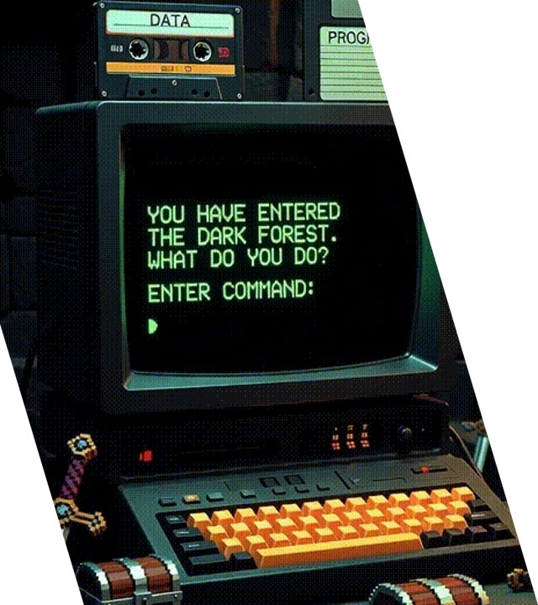
[USECASE] T.A.G. DEMO
The Text Adventure Generator

Slide 25

[USECASE] T.B.A. DEMO
Meet your new digital assistant tailored for your role.
“The Technical Business Analyst”

Slide 26
NEXT STEP: Performance! It’s currently eating tokens, like a fruitmachine!
I was talking to another AI enthousiast lately and presented this framework. He immediately recognised the footprint and is working on an elegant solution to this problem. He created a local abstraction, which digests a prompt, breaks it down and rewrites it to logarithms before sending it to the LLM. Basically a performance abstraction. I’m currently running “side by side” tests to see if the performance gains doesn’t lose the quality and details from the original prompt. Other attempts at compressing have failed so far.
Below an example how an optimized <STATE> and <GAMELOOP> could look like. If this works it’s a compression of 90% on the entire prompt.
Optimised state:
StateModel_t = \{user, q_t, s_t, D_t, flags_t\}Model_{t+1} = f(Model_t, Input_t)
Optimised reasoning:
Loop = [Read, Heal, Update, Narrate, Options, Output]Output_t = View(Narrate(\Delta Model_t), Options(Model_{t+1}))

Slide 27
FUN FACTS
The OSINT (Open Source Intelligence) team of the Dutch police adopted my framework to help them in their investigations.
I posted an article in r/textadventures and got angry replies from textadventure / development purists.
emilythered: “Boo. Write your own game. I'm a novice but I'd rather code something than get lazy.”
mild_area_alien: … “The whole thing about those games is that they had people behind them who had put thought into how the game would unfold, what the overarching objectives were, where to add in puzzles, etc. GenAI just vomits out text.” …

Slide 28

Thank you & QUESTIONS
SCAN ME TO COLLABORATE
Find the full Master Prompt and all examples on GitHub:
https://github.com/jvanheerikhuize/prompt-gallery

Slide 30
Introduction
For decades, software engineering has been an art of building deterministic output out of components with the same nature.
We are now facing a paradigm shift:
“Building deterministic outputs using probabilistic tools”

Slide 31
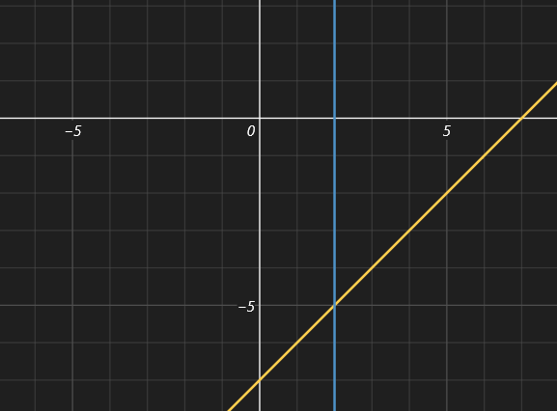
CURRENT STATE: REAL-LIFE DETERMINISTIC EXAMPLE
Building block X
Input: x = 2
}
System Z
(draw a system of coordinates)
Building block Y
Input: y = -5

Slide 32
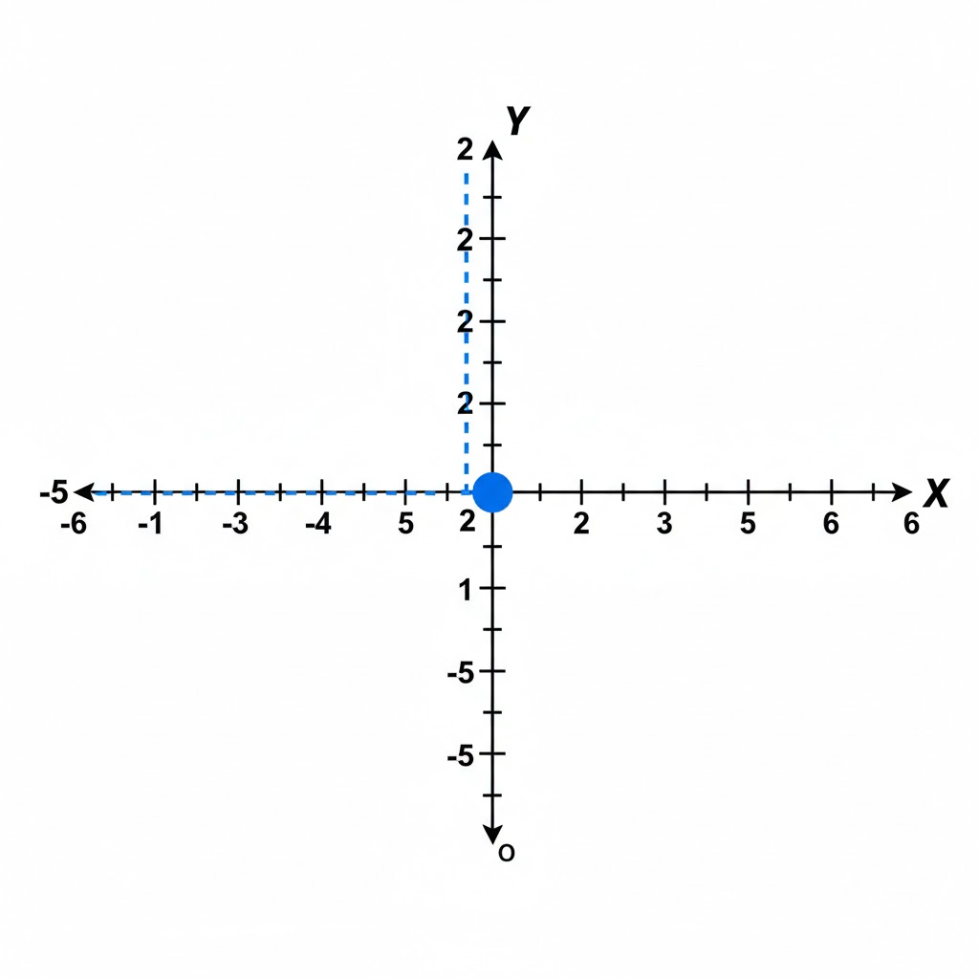
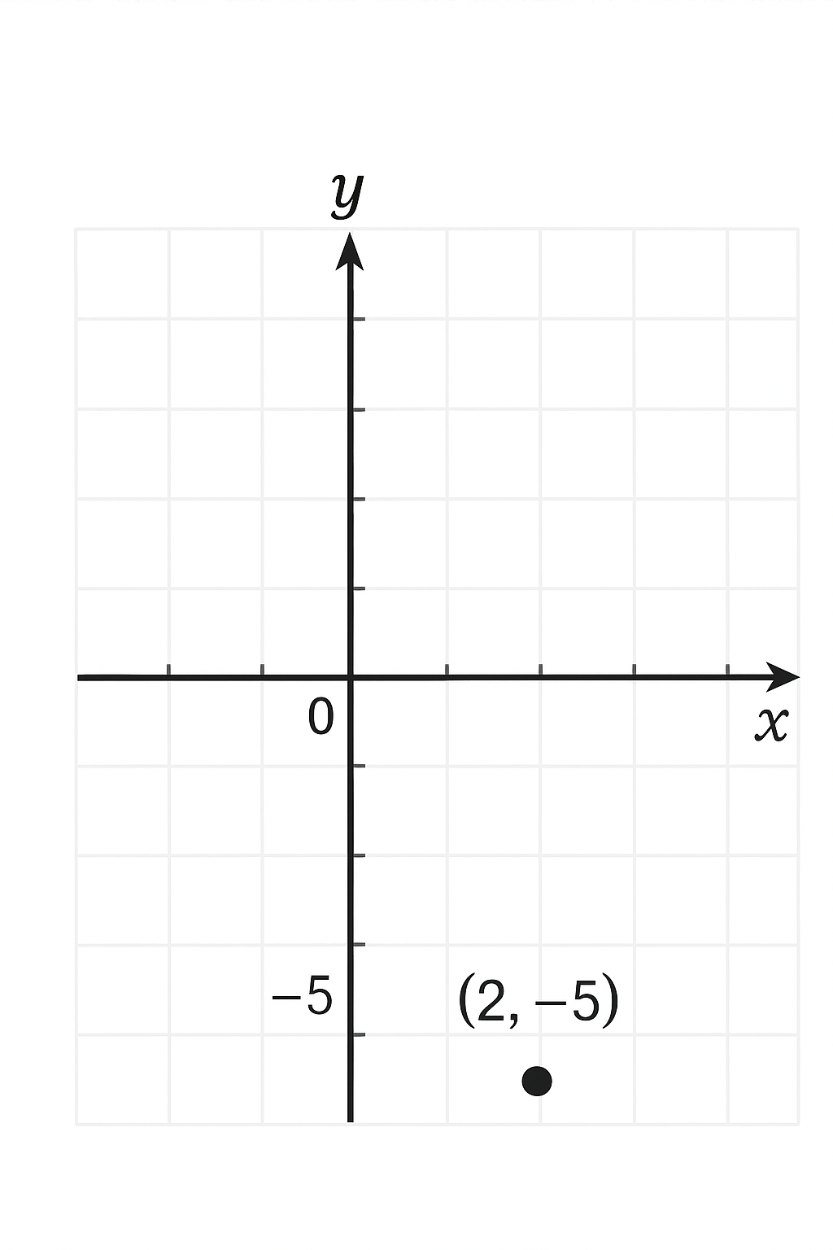
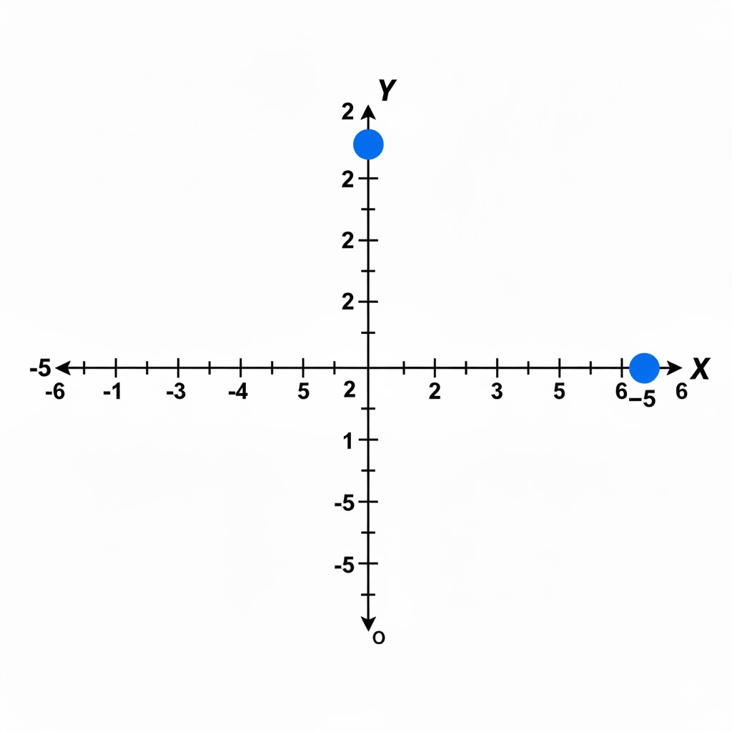
CURRENT STATE: AI AUGMENTED DETERMINISTIC EXAMPLE ???????
Input: x = 2
}
System Z
(draw a system of coordinates)
Input: y = -5

Slide 33
DESIRED STATE: PROBABILISTIC EXAMPLE AI AUGMENTED
Input: x = 2
}
System Z
(draw a system of coordinates)
Input: y = -5

Slide 34
Introduction
This forces us to move our focus completely.
verifying predictable logic
validating probabilistic outputs
Let that sink in for a while. “A Shift Right?!?”

